Slide 1


Targeted Marketing as a Social Determinant of Health
Jacob E. Thomas, MA
Doctoral Fellow
The University of Texas at Austin
College of Education
Health Behavior and Health Education Program
UT Health Science Center
School of Public Health
Austin Regional Campus
Michael & Susan Dell Center for Healthy Living

Slide 2
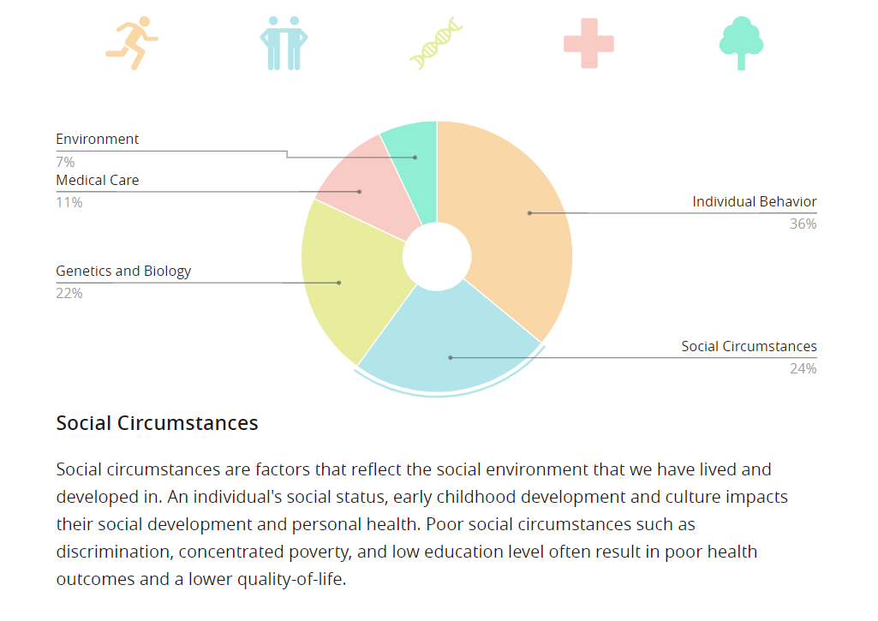
Determinants of Health

Slide 3

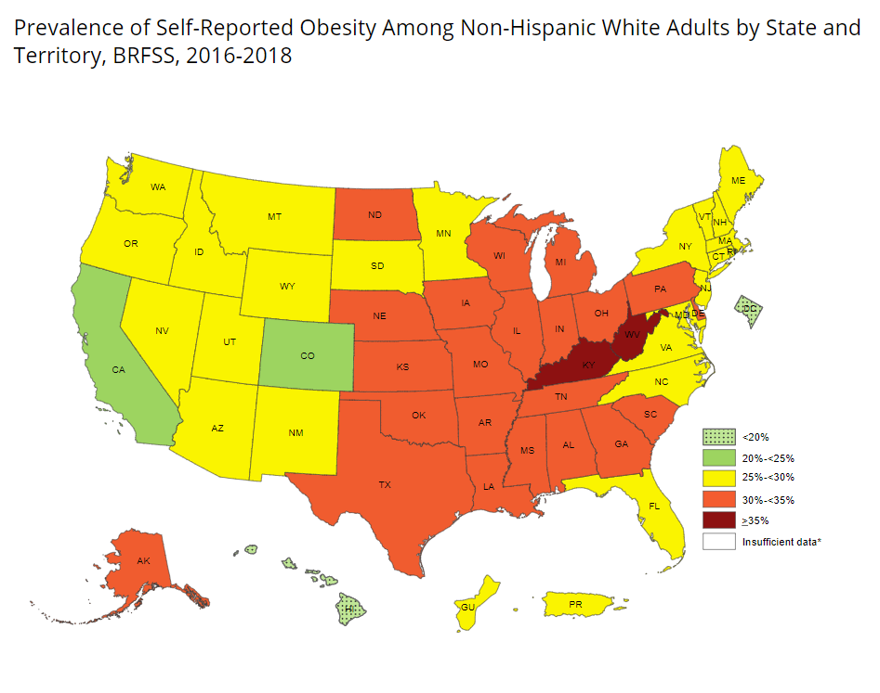
Data From CDC

Slide 4
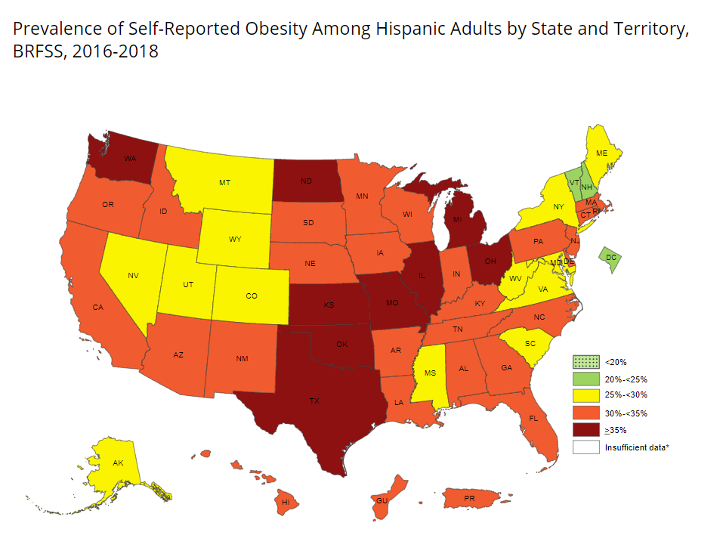
Data From CDC

Slide 5
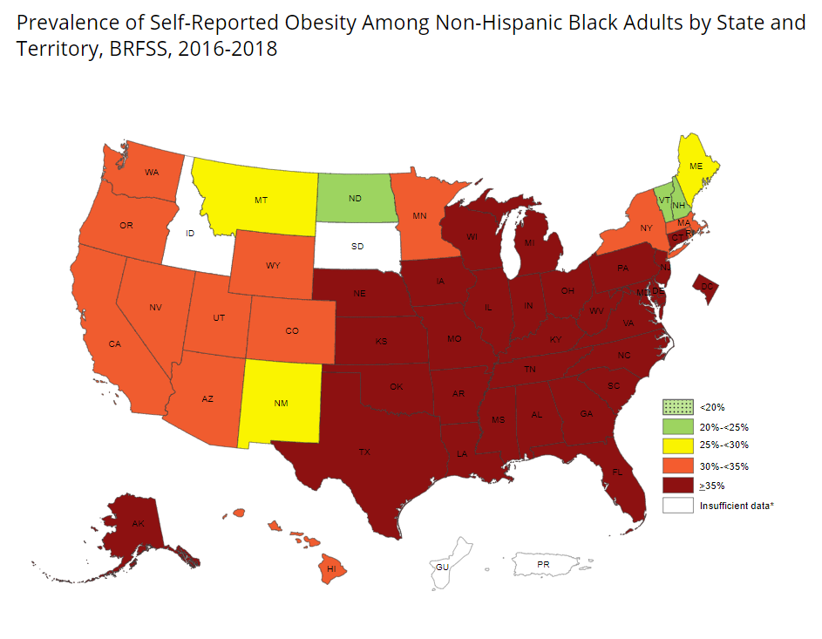
Data From CDC

Slide 6

Final Project for McCombs Data Program
Data: Blend of preoperatory data to UT collected by a $20,000,000 grant from the FDA/NIH/CDC, and public data from the Texas Education Agency
Technologies Used: Excel, HTML, CSS, Bootstrap, JavaScript, CanvasJS, Python, Jupyter, Pandas, SciPy, MatPlotLib, NumPy, SciKit-Learn
Goal:
Broadly - introduce Social Determents of Health
Specifically - show that the food environment is an important, but often overlooked health risk factor

